Slide 1
Review
OSI L2/L3

Slide 2
The OSI Model
Notes:
While the OSI model doesn’t map perfectly to the network protocol stack that was adopted in practice, it’s so conceptually useful that it’s stood the test of time. In this chapter, we discuss vulnerabilities of, attacks against, and countermeasures for most of these layers. Students must understand what each layer is and that useful attacks can occur at any layer, so all require protecting.

Slide 3
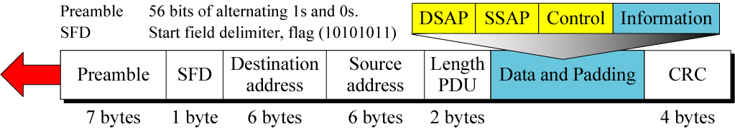
IEEE 802.3 MAC Frame

Slide 4

Ethernet Address in Hexadecimal Notation

Slide 5
Ethernet MAC Addresses
It identifies source and destination interfaces, length of MAC address fields (DA and SA) is 6 bytes or 48 bits.
MAC address is generally written as six pairs of hexadecimal digits separated by dashes.
According to the IEEE standard, the least significant bit of the network address is the leftmost bit of the MAC address field and the most significant bit is the rightmost bit of the MAC address field.
EUI-64 is a concatenation of the 24-bit company_id value (OUI) by the IEEE Registration Authority (IRA) and a 40-bit extension identifier that is assigned by the organization with that company_id assignment.

Slide 6
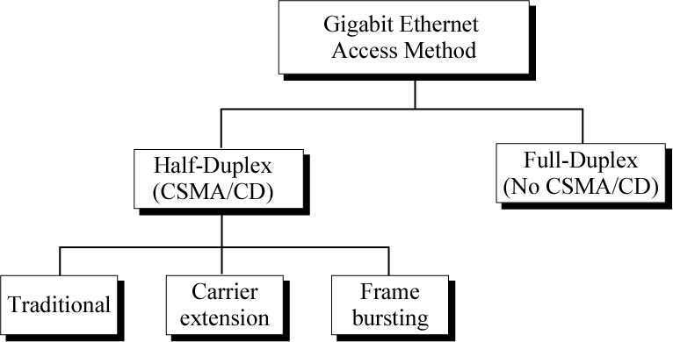
Two Approaches in Gigabit Ethernet
Medium Access

Slide 7
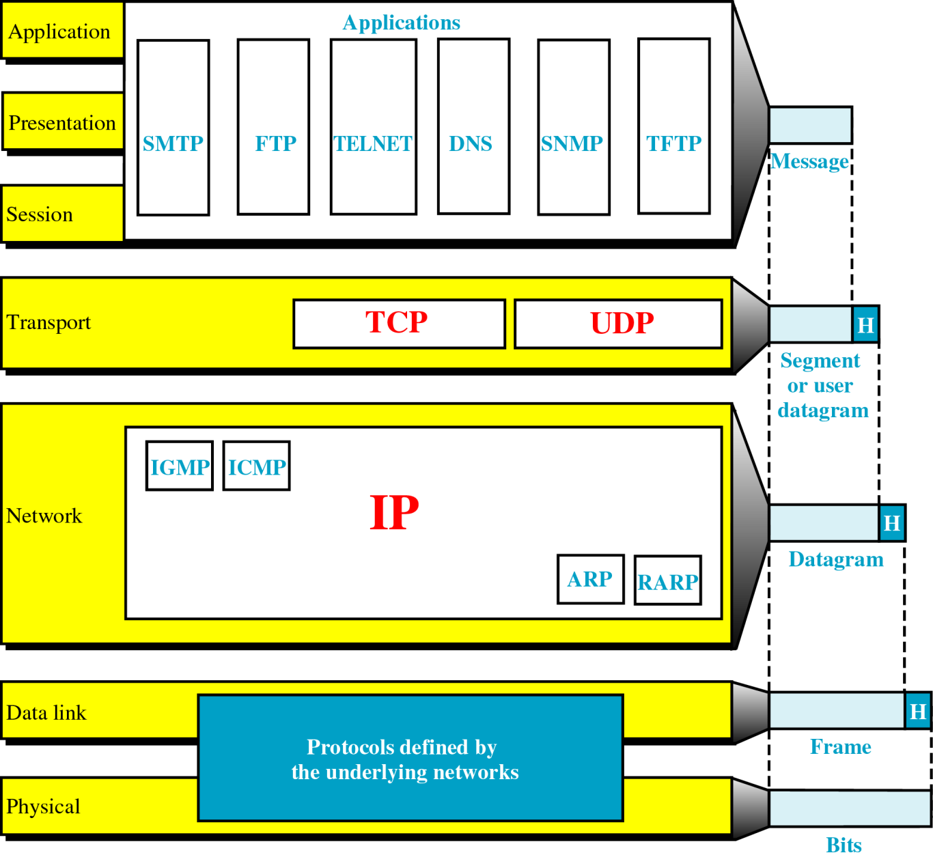
TCP/IP and the OSI Model

Slide 8
Internet Protocol
Provides best effort, connectionless packet delivery
motivated by need to keep routers simple and by adaptibility to failure of network elements
packets may be lost, out of order, or even duplicated
higher layer protocols must deal with these, if necessary
RFCs 791, 950, 919, 922, and 2474.
IP is part of Internet STD number 5, which also includes:
Internet Control Message Protocol (ICMP), RFC 792
Internet Group Management Protocol (IGMP), RFC 1112

Slide 9
IP Packet Header
0 4 8 16 19 24 31
Version IHL Type of Service Total Length
Identification Flags Fragment Offset
Time to Live Protocol Header Checksum
Source IP Address
Destination IP Address
Options Padding
Minimum 20 bytes
Up to 40 bytes in options fields (So, Maximum is 60 bytes)

Slide 10
IP Packet Header
0 4 8 16 19 24 31
Version IHL Type of Service Total Length
Identification Flags Fragment Offset
Time to Live Protocol Header Checksum
Source IP Address
Destination IP Address
Options Padding
Version: current IP version is 4.
Internet header length (IHL): length of the header in 32-bit words.
Type of service (TOS): traditionally priority of packet at each router. Recent Differentiated Services redefines TOS field to include other services besides best effort.

Slide 11
Differentiated Services(DS)
8 bits to provide desired quality of service (QoS) to packets depending upon traffic type.
Leftmost 6 bit are used a codepoint (DSCP) to select per-hop behavior (PHB), a packet experience at each node.
Routers examine DS field and provide necessary treatment to the packet.
Remaining 2 bits on right are called explicit congestion notification (ECN) field and are used to indicate congestion in the network.
00:Non-ECN-capable transport-Non-ECT
10:ECN capable transport-ECT(0)
01:ECN capable transport-ECT(1)
11:Congestion encountered-CE
Either of ECT(0) and ECT(1) can be used by the data sender. When a router detects congestion it sets ECN bits to 11 (CE) for receiver to know about congestion.

Slide 12
Options Area of IPv4 (Up to 40 bytes)
The Options field allows a packet to request special features. Some of such options are
Security – Routers to avoid on the path
Record Route – Each router puts its address in the options area so that entire route from source to destination may be traced
Source Route - Route to be taken by the packet as decided by the source,
Loose Source Route – No route put by source but lists routers not to be missed as the packet moves towards destination,
Timestamp – Time value put by each router.

Slide 13
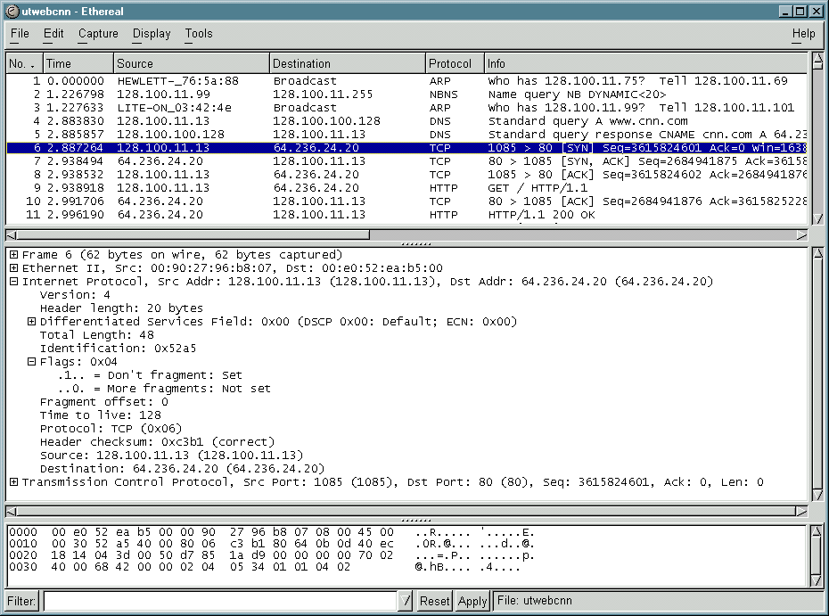
Example of IP Header

Slide 14
Header Checksum
IP header uses check bits to detect errors in the header
A checksum is calculated for header contents
Checksum recalculated at every router, so algorithm selected for ease of implementation in software
Let header consist of L, 16-bit words,
b₀, b₁, b₂, ..., b_{L-1}
The algorithm appends a 16-bit checksum b_{L}

Slide 15
Checksum Calculation
The checksum b_{L} is calculated as follows:
Treating each 16-bit word as an integer, find
x = b₀ + b₁ + b₂+ ...+ b_{L-1} modulo 2¹⁵-1
The checksum is then given by:
b_{L} = - x modulo 2¹⁵-1
This is the 16-bit 1’s complement sum of the b’s
If checksum is 0, use all 1’s representation (all zeros reserved to indicate checksum was not calculated)
Thus, the headers must satisfy the following pattern:
0 = b₀ + b₁ + b₂+ ...+ b_{L-1} + b_{L} modulo 2¹⁵-1

Slide 16
IP Header Processing
Compute header checksum for correctness and check that fields in header (e.g. version and total length) contain valid values
Consult routing table to determine next hop
Change fields that require updating (TTL, header checksum)

Slide 17
IP Addressing in IPv4
Every host on the Internet must have a valid IP address.
The Internet Assigned Numbers Authority (IANA) is responsible for allocating blocks of addresses to Internet Service Providers (ISPs).
It is operated by the Internet Corporation for Assigned Names and Numbers (ICANN).
An IP address could be static or dynamic.
A host is said to be multihomed if it has multiple IP addresses.
An IP address consists of two parts–a network portion and a host portion.

Slide 18
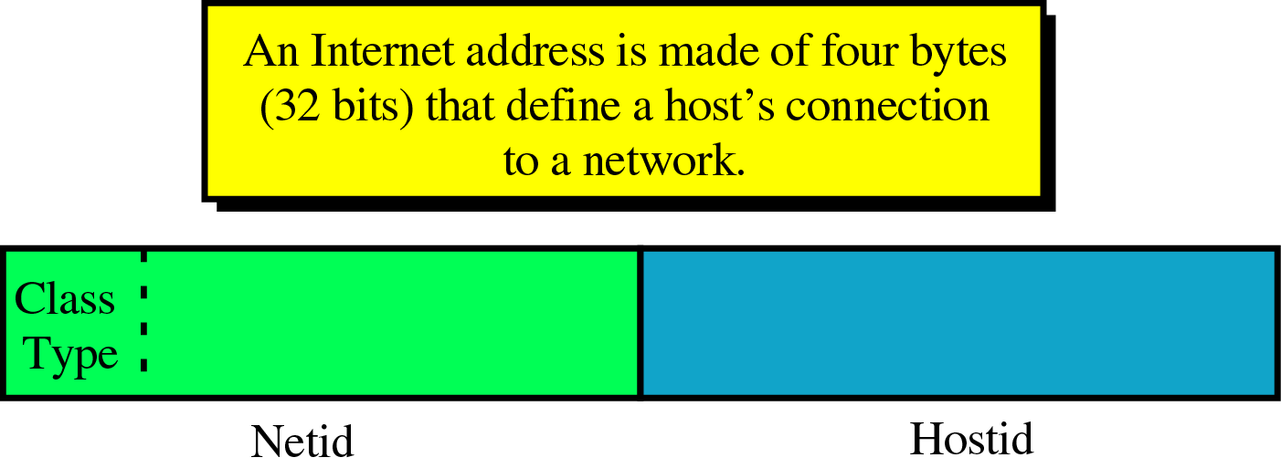
Internet Address

Slide 19
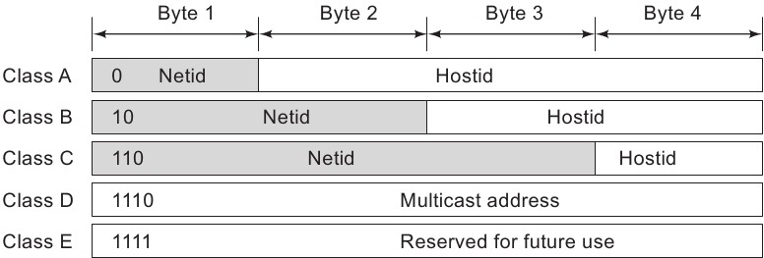
Internet Address Classes
The Internet addresses are divided into five classes.
Only three classes are significant for unicast addressing. This addressing mechanism is also known as Classful Addressing.
Each of these classes provides a number of networks and each network supports a number of hosts.

Slide 20
Reserved Host IDs (all 0s & 1s)
Internet address used to refer to network has hostid set to all 0s
this host
(used when
booting up)
0
0
0
0
0
0
a host
in this
network
0
0
0
host
Broadcast address has hostid set to all 1s
broadcast on local network
1
1
1
1
1
1
1
1
broadcast on distant network
netid
1
1
1
1
1

Slide 21
Reserved Addresses Identifiers
Address 0.0.0.0 is allocated while booting or in the initialization phase
Address NetId.0 (i.e., when HostId portion is set to all zeros) refers to network identification.
An address 0.HostId refers to the host on local network.
Any address between 127.0.0.1 and 127.0.0.254 is called the loopback address set aside for testing purposes.
An address 255.255.255.255 means broadcast in the local network. It does not mean a broadcast in the entire Internet.
NetId.111...11 (i.e., network identifier followed by all ones in the host portion) refers to broadcast in the particular network.
Internet address used to refer to a network has HostId set to all 0s.
The addresses from 169.254.0.0./16 range is assigned upon booting when DHCP server is unavailable.

Slide 22
Private IP Addresses
Specific ranges of IP addresses set aside for use in private networks (RFC 1918)
Their use restricted to private networks; Routers in public Internet discard packets with these unregistered addresses
Range 1: 10.0.0.0 to 10.255.255.255
Range 2: 172.16.0.0 to 172.31.255.255
Range 3: 192.168.0.0 to 192.168.255.255
Network Address Translation (NAT) used to convert between private & global IP addresses

Slide 23
Example of IP Addressing
128.135.40.1
128.140.5.40
H
Interface
Address is
128.135.10.2
Interface
Address is
128.140.5.35
H
Network
128.135.0.0
Network
128.140.0.0
R
H
H
H
128.135.10.20
128.135.10.21
128.140.5.36
Address with host ID=all 0s refers to the network
Address with host ID=all 1s refers to a broadcast packet
R = router
H = host

Slide 24
Subnet Addressing and Classless Inter Domain Routing (CIDR)
Subnet refers to a network that has been divided into different small networks.
For the outside world, all subnets or parts appear as a single network unit.
If a subnet mask is 255.255.255.0 the ones indicate the subnet portion and the zeros are the host portion. This mask is also written as /24 which implies that the first 24 bits in the subnet mask are all ones.
A subnet may be created by using Classless Inter Domain Routing (or CIDR). This method of allocating addresses does not consider the concept of classes. RFC 1519 mentions some reasons for adopting CIDR scheme.

Slide 25
Network vulnerabilities (1)
Network characteristics significantly increase security risks
These vulnerability-causing characteristics include:
Attacker anonymity
Attacker can be far away
Can disguise attack origin (pass through long chain of hosts)
Weak link: computer-to-computer authentication
Many points of origin and target for attacks
Data and interactions pass through many systems on their way between user and her server
Each system can be origin of an attack or target for attack
Systems might have widely different security policies/mechanisms

Slide 26
Network vulnerabilities (2)
Resource and workload sharing
More users have access to networks than to stand-alone systems
More systems have access to networks
Network complexity
Complexity much higher in networks than in single OSs
Unknown or dynamic network perimeter
Dynamic in any network, unknown in network w/o single administrative control
Any new host can be untrustworthy
Administrator might not known that some of hosts of his network are also hosts in another network
Hosts are free to join other networks

Slide 27
Network vulnerabilities (3)
Uknown paths between hosts and users
Many paths
Network decides which one chosen
Network might change path any time
Nonuniform security policies/mechanisms for hosts belonging to multiple networks
If Host H belongs to N1 and N2, does it follow:
N1’s rules?
N2’s rules?
Both?
What if they conflict?
Active vs Passive attacks - IAA vs C
Insider attack vs outsider attack - Perimeter, authorized

Slide 28
Threats to Network Communications
Interception, or unauthorized viewing
Modification, or unauthorized change
Fabrication, or unauthorized creation
Interruption, or preventing authorized access
Notes:
The previous slides presented some basic background on networking. This slide begins a long section on threats to networks. Each of these bullets will get a group of detailed slides.

Slide 29
Modification and Fabrication
Data corruption
May be intentional or unintentional, malicious or nonmalicious, directed or random
Sequencing
Permuting the order of data, such as packets arriving in sequence
Substitution
Replacement of one piece of a data stream with another
Insertion
A form of substitution in which data values are inserted into a stream
Replay
Legitimate data are intercepted and reused
Notes:
This slide ends the section on interception and moves on to modification and fabrication. Data corruption sources are illustrated on the next slide, and a replay example on the following. It’s helpful here to have students attempt to come up with examples of how each of these can result in a bad outcome.

Slide 30
Sources of Data Corruption

Slide 31
Simple Replay Attack

Slide 32
Address Resolution Protocol (ARP)
Although IP address identifies a host, the packet is physically delivered by an underlying network (e.g., Ethernet) which uses its own physical address (MAC address in Ethernet). How to map an IP address to a physical address?
H1 wants to learn physical address of H3 -> broadcasts an ARP request
H1
H2
H3
H4
150.100.76.20
150.100.76.21
150.100.76.22
150.100.76.23
ARP request (what is the MAC address of 150.100.76.22?)
Every host receives the request, but only H3 reply with its physical address
H1
H2
H3
H4
ARP response (my MAC address is 08:00:5a:3b:94)

Slide 33
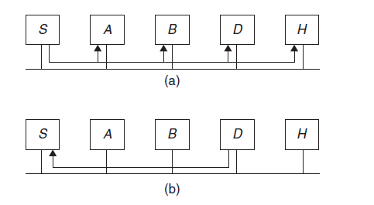
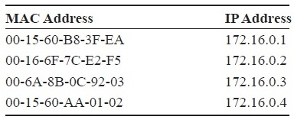
Address Resolution Protocol (ARP)
(a) ARP request is broadcast and (b) ARP reply from destination is unicast.
ARP table/cache at a host

Slide 34
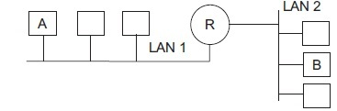
Proxy ARP
When a machine requesting MAC address corresponding to an IP address is behind a router and destination machine is on a network outside the collision domain of requesting machine, the concept of proxy ARP is used.
ARP works on local network only.
ARP request cannot be forwarded on other side of the router. In this case, when a router receives an ARP request for an IP address which is on another collision domain or network, it sends an ARP reply containing the MAC address of its own interface connecting it to the requesting machine's network.

Slide 35
ARP Spoofing
The ARP table is updated whenever an ARP response is received
Requests are not tracked
ARP announcements are not authenticated
Machines trust each other
A rogue machine can spoof other machines

Slide 36
ARP Poisoning (ARP Spoofing)
According to the standard, almost all ARP implementations are stateless
An arp cache updates every time that it receives an arp reply… even if it did not send any arp request!
It is possible to “poison” an arp cache by sending gratuitous arp replies

Slide 37
ARP Caches
IP: 192.168.1.1
MAC: 00:11:22:33:44:01
IP: 192.168.1.105
MAC: 00:11:22:33:44:02
Data
192.168.1.1 is at 00:11:22:33:44:01
192.168.1.105 is at 00:11:22:33:44:02
ARP Cache
192.168.1.105 | 00:11:22:33:44:02
ARP Cache
192.168.1.1 | 00:11:22:33:44:01

Slide 38
Poisoned ARP Caches (man-in-the-middle attack)
192.168.1.106
00:11:22:33:44:03
Data
Data
192.168.1.105 is at 00:11:22:33:44:03
192.168.1.1 is at 00:11:22:33:44:03
192.168.1.1
00:11:22:33:44:01
192.168.1.105
00:11:22:33:44:02
Poisoned ARP Cache
192.168.1.105 | 00:11:22:33:44:03
Poisoned ARP Cache
192.168.1.1 | 00:11:22:33:44:03

Slide 39
ARP Spoofing
Using static entries solves the problem but it is almost impossible to manage!
Check multiple occurrence of the same MAC
i.e., One MAC mapping to multiple IP addresses (see previous slide’s example)
Software detection solutions
Xarp, Arpwatch

Slide 40
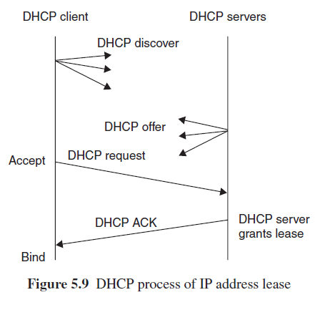
Dynamic Host Configuration Protocol
It allow a client to request IP addresses and configuration information dynamically from a server to client.
DHCP server owns all IP addresses and it actually leases them to clients for a certain period.

Slide 41
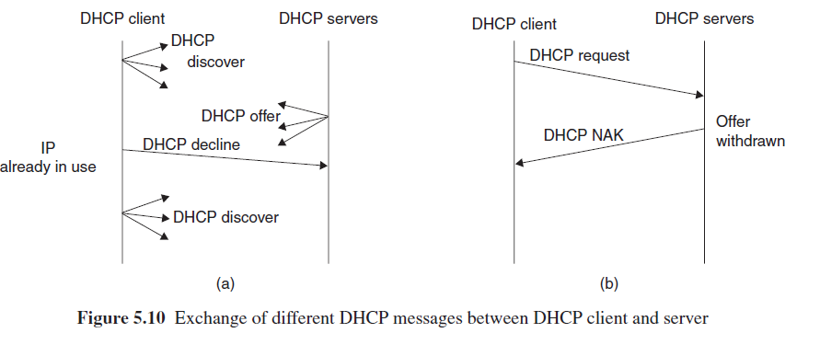
DHCP
Exchange of different DHCP messages between DHCP client and server.

Slide 42
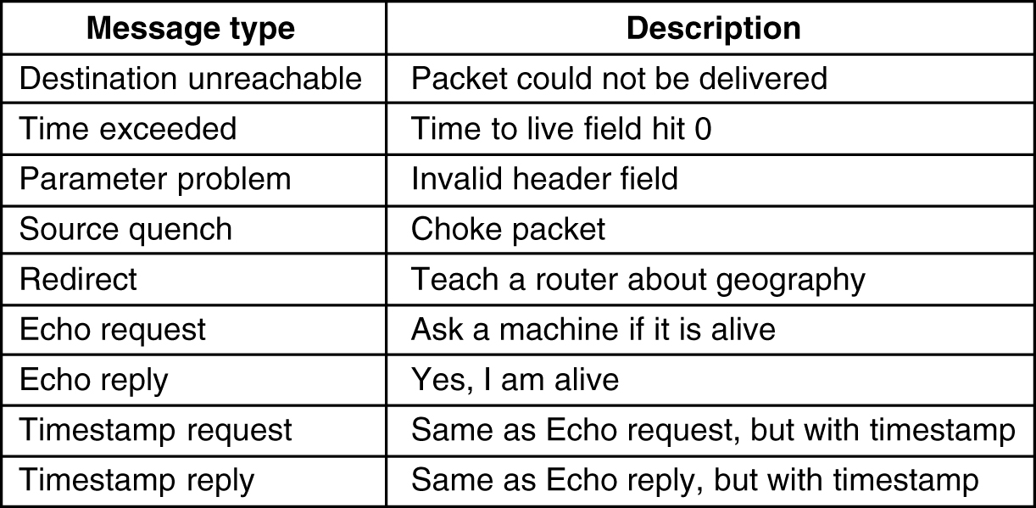
Internet Control Message Protocol
The principal ICMP message types.
5-61

Slide 43
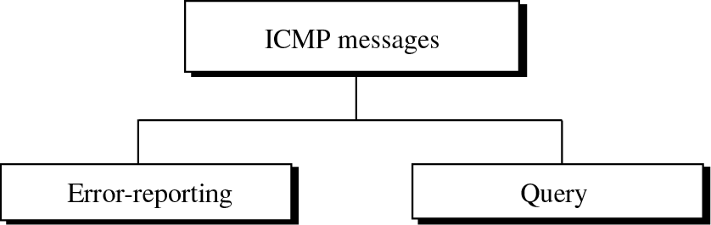
Categories of ICMP Messages

Slide 44
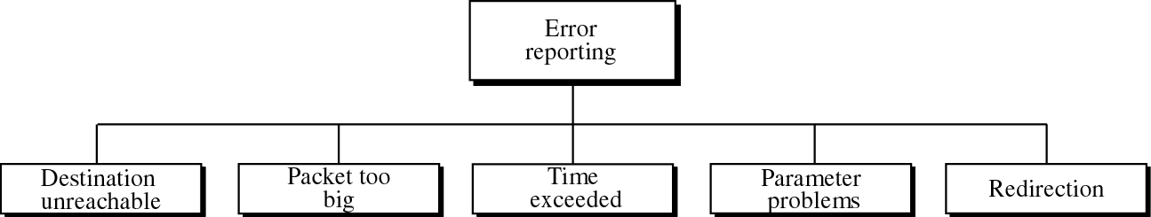
Types of Error-Reporting Messages

Slide 45
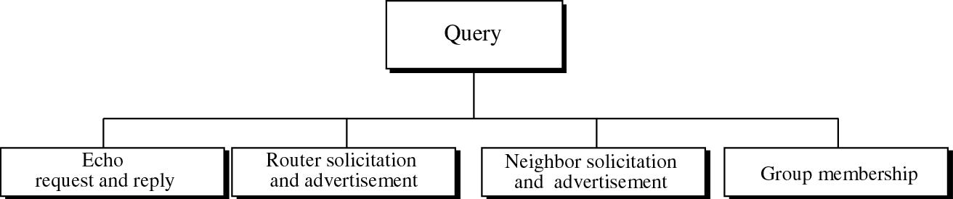
Types of Query Messages

Slide 46
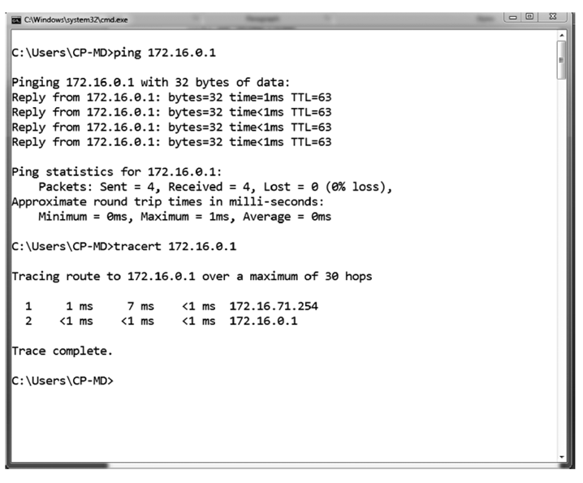
Internet layer Protocols

Slide 47
Denial-of-Service (DoS) Attack
Real IP-based attack using botnets
Attacker does not worry about exposing bots’ IP addresses.
TCP flooding, UDP flooding, icmp flooding
Spoofed IP-based attack
SYN flooding with spoofed IPs.
Source address hiding attack
Smurf attack (DDOS attack – uses amplification unlike ping)

Slide 48
Description of Smurfing Attack
Uses ICMP echo/reply packets with broadcast networks to multiply traffic
Requires the ability to send spoofed packets
Abuses “bounce-sites” to attack victims
Traffic multiplied by a factor of 50 to 200
Router broadcasts to
all LAN’s computers

Slide 49
How to prevent being a “bounce site”
Turn off directed broadcasts to subnets with 5 hosts or more
Cisco router: Interface command “no ip directed-broadcast”
Use ACL (if necessary) to prevent ICMP echo requests from entering your network
Makes troubleshooting difficult
But many networks do this
Encourage vendors to turn off replies for ICMP echos to broadcast addresses
Host Requirements RFC-1122 Section 3.2.2.6 states “An ICMP Echo Request destined to an IP broadcast or IP multicast address MAY be silently discarded.”

Slide 50
IPv6
Longer address field:
128 bits can support up to 3.4 x 10³⁸ hosts
Simplified header format:
Simpler format to speed up processing of each header
All fields are of fixed size
IPv4 vs IPv6 fields:
Same: Version
Dropped: Header length, ID/flags/frag offset, header checksum
Replaced:
Datagram length by Payload length
Protocol type by Next header
TTL by Hop limit
TOS by traffic class
New: Flow label

Slide 51
Other IPv6 Features
Flexible support for options: more efficient and flexible options encoded in optional extension headers
Flow label capability: “flow label” to identify a packet flow that requires a certain QoS
Security: built-in authentication and confidentiality
Large packets: supports payloads that are longer than 64 K bytes, called jumbo payloads.
Fragmentation at source only: source should check the minimum MTU along the path
No checksum field: removed to reduce packet processing time in a router

Slide 52
IPv6 Header Format
0 4 12 16 24 31
Version Traffic Class
Flow Label
Payload Length Next Header Hop Limit
Source Address
Destination Address
Version field same size, same location
Traffic class to support differentiated services
Flow: sequence of packets from particular source to particular destination for which source requires special handling

Slide 53
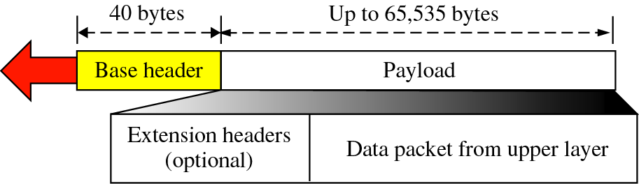
IPv6 Datagram

Slide 54
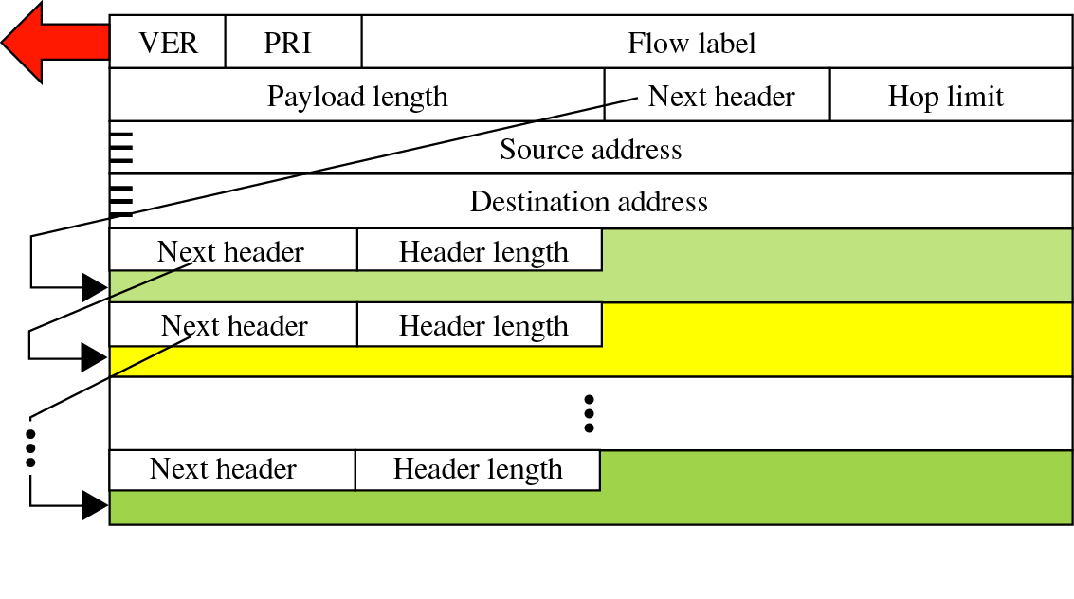
Extension Header Format

Slide 55
Extension Headers
Daisy chains of extension headers
Basic header
Next header =
TCP segment
TCP
Basic header
Routing header
Fragment header
Authentication header
Next header =
Next header =
Next header =
Next header =
TCP segment
routing
fragment
authentication
TCP
Extension headers processed in order of appearance

Slide 56
Six Extension Headers
Header code | Header type
0 | Hop-by-hop options header
43 | Routing header
44 | Fragment header
51 | Authentication header
52 | Encapsulating security payload header
60 | Destination options header (for intermediate Destinations and also for Final Destination)

Slide 57
IPv6 over IPv4 Tunneling
IPv6 Packet
IPv6 Header
Extension
Headers
Upper Layer Protocol Data Unit
IPv4 Header
IPv6 Header
Extension
Headers
Upper Layer Protocol Data Unit
IPv4 Packet

Slide 58
Address Autoconfiguration (1)
Allow plug and play
BOOTP and DHCP are used in IPv4
DHCPv6 used with IPv6
Two Methods: Stateless and Stateful

Slide 59
Security Issues in IP
Source spoofing
Replay packets
No data integrity or confidentiality
DOS attacks
Replay attacks
Spying
and more…

Slide 60
Goals of IPSec
To verify sources of IP packets
authentication
To prevent replaying of old packets
To protect integrity and/or confidentiality of packets
data Integrity/Data Encryption

Slide 61
The IPSec Security Model
Secure
Insecure

Slide 62
IPSec Architecture
IPSec provides security in three situations:
Host-to-host, host-to-gateway and gateway-to-gateway
IPSec operates in two modes:
Transport mode (for end-to-end)
Tunnel mode (for VPN)

Slide 63
IPSec Architecture
ESP
AH
Encapsulating Security
Payload
Authentication Header
IPSec Security Policy
IKE
The Internet Key Exchange

Slide 64
IPv6 Security – IPsec mandated
IPsec is mandated in IPv6
This means that all implementations (i.e. hosts, routers, etc) must have IPsec capability to be considered as IPv6-conformant

Slide 65
IPv6 Security – harder to scan networks
With IPv4, it is easy to scan a network
With tools like nmap, can scan a typical subnet in a few minutes
Returning list of active hosts and open ports
Many worms also operate by scanning
e.g. Blaster, Slammer
Attackers (& worms) scan for proxies, weak services and back doors

Slide 66
IPv6 Security – harder to scan networks
With IPv6, sparse address allocation makes such brute force scanning very difficult

Slide 67
IPsec Components
1) Protocols:
Authentication Header (AH):- Provides access control, connectionless message integrity, authentication, and anti-replay protection.
Encapsulating Security Payload (ESP):- Provides all the above services plus confidentiality (Encryption).
2) Key Management:
ISAKMP: defines procedures and packet formats to establish, negotiate, modify and delete security associations.
Security Association (SA): An SA is a simplex (one-way) connection that is protected by one or more available security services.

Slide 68
IPSec Modes of Operation
Transport Mode: Transport mode encrypts only the data portion (payload) of each packet, but leaves the header untouched.
It is more efficient and the end points are obvious.
Tunnel Mode: is the way Mobile-IP works or the VPN are constructed.
It is less efficient but hides the network behind the security gateways. the traffic of the several networks can be concealed in one tunnel making traffic analysis difficult.
It encrypts both the data and the header.

Slide 69
Transport Mode
IPSec implementation in end-to-end communication scheme

Slide 70
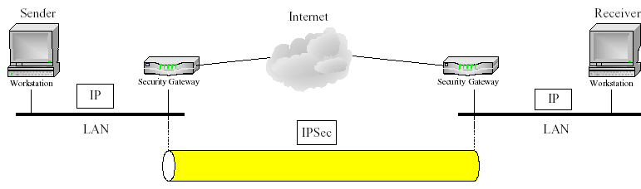
Tunnel Mode
IPSec implemented between security gateways.

Slide 71
IPSec
A collection of protocols (RFC 2401)
Authentication Header (AH)
RFC 2402
Encapsulating Security Payload (ESP)
RFC 2406
Internet Key Exchange (IKE)
RFC 2409
IP Payload Compression (IPcomp)
RFC 3137

Slide 72
Authentication Header (AH)
Provides source authentication
Protects against source spoofing
Provides data integrity
Protects against replay attacks
Use monotonically increasing sequence numbers
Protects against denial of service attacks
AH is a protocol that provides authentication of either all or part of the contents of a datagram through the addition of a header that is calculated based on the values in the datagram
NO protection for confidentiality!

Slide 73
AH Details
Use 32-bit monotonically increasing sequence number to avoid replay attacks
Use cryptographically strong hash algorithms to protect data integrity (96-bit)
Use symmetric key cryptography
HMAC-SHA-96, HMAC-MD5-96

Slide 74
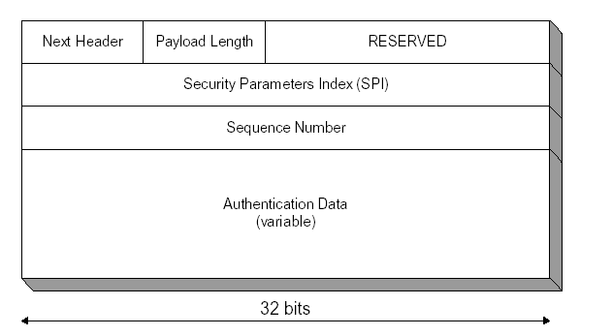
AH Packet Details
SA between two ends is set up that specifies hashing particulars so that the source and destination know how to perform the computation but nobody else can.
On the source device, AH performs the computation and puts the result (called the Integrity Check Value or ICV) into the special header with other fields for transmission.
Destination does the same calculation using the key the two ends share, which enables it to see immediately if any of the fields in the original datagram were modified (either due to error or malice).

Slide 75
Encapsulating Security Payload (ESP)
Provides all that AH offers, and
In addition provides data confidentiality
Uses symmetric key encryption
It is recommended to use ESP

Slide 76
ESP Details
Same as in AH:
Use of 32-bit sequence number to counter replaying attacks
Use of integrity check algorithms
Only in ESP:
Data confidentiality:
Uses symmetric key encryption algorithms to encrypt packets

Slide 77
Encapsulating Security Payload (ESP)
ESP provides authentication and encryption of the payload
ESP header format

Slide 78
Transport Mode AH
AH in this mode also authenticates the IP header fields.
Transport Mode AH using IPv4 and IPv6.

Slide 79
Transport Mode ESP
Transport Mode ESP using IPv4 and IPv6.
ESP trailer is used for adding the padding and the NextHdr fields.
ESP Authentication is used when authentication is carried by ESP

Slide 80
Tunnel Mode AH
In tunnel mode, the payload includes the original IP header.

Slide 81
Tunnel Mode ESP
Tunnel mode ESP using IPv4 and IPv6

Slide 82
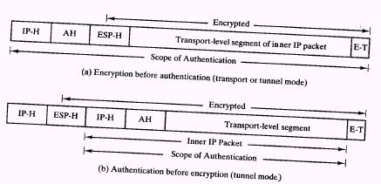
Encryption before/after Authentication.
Advantage of applying Authentication before Encryption
Since AH is protected by ESP it is impossible for anyone to intercept the messages and alter the AH without detection.
If it is required to store the Authentication Information it is beneficial as the authentication information applies to the plaintext message and not cipher-text message

Slide 83
IPsec Encapsulation Modes
 | Transport Mode | Tunnel Mode
AH | Authenticates IP payload and selected portions of IP header and IPv6 extension headers | Authenticates entire inner IP packet plus selected portions of outer IP header
ESP | Encrypts IP payload and any IPv6 extension header | Encrypts inner IP packet
ESP with Authentication | Encrypts IP payload and any IPv6 extesion header. Authenticates IP payload but no IP header | Encrypts inner IP packet. Authenticates inner IP packet but no outer IP header

Slide 84
Internet Key Exchange (IKE)
Exchange and negotiate security policies
Establish security sessions
Identified as Security Association
Key exchange
Key management
Can be used outside IPsec as well

Slide 85
IPsec/IKE Acronyms Security Association (SA)
In order to communicate, each pair of hosts must set up SA with each other
Acts as virtual connection for which various parameters are set:
Type of protection
Algorithms
Keys
…
Simplex: a one way relationship between a sender and a receiver.
For either AH or ESP, but not both

Slide 86
Security Association (SA)
Each SA uniquely identified by:
Security Parameters Index (SPI)
32-bit string assigned to this SA (local meaning only)
IP destination address of packets
May be end user system, or firewall or router
Security Protocol Identifier (e.g. AH, ESP)
For each IP packet, governing SA is identified by:
Destination IP address in packet header
SPI in extension header (AH or ESP)

Slide 87
IPsec/IKE Acronyms
Security Association (SA)
Is asymmetric!
One SA for inbound traffic, another SA for outbound traffic
Similar to ciphersuites in SSL (set of cryptographic algorithms)
Security Association Database (SADB)
A database of Sas
Security Policy Database (SPD)
Store policies used to establish SAs

Slide 88
How They Fit Together
SPD
SA-1
SA-2
SADB
SPI
SPI

Slide 89
SPD and SADB Example
Transport Mode
A’s SPD
From | To | Protocol | Port | Policy
A | B | Any | Any | AH[HMAC-MD5]
A
B
C
D
Tunnel Mode
From | To | Protocol | SPI | SA Record
A | B | AH | 12 | HMAC-MD5 key
A’s SADB
From | To | Protocol | Port | Policy | Tunnel Dest
 |  | Any | Any | ESP[3DES] | D
A_{sub}
B_{sub}
C’s SPD
From | To | Protocol | SPI | SA Record
 |  | ESP | 14 | 3DES key
C’s SADB
A_{sub}
B_{sub}

Slide 90
How It Works
IKE operates in two phases
Phase 1: negotiate and establish an auxiliary end-to-end secure channel
Used by subsequent phase 2 negotiations
Only established once between two end points!
Phase 2: negotiate and establish custom secure channels
Occurs multiple times
Both phases use Diffie-Hellman key exchange to establish a shared key

Slide 91
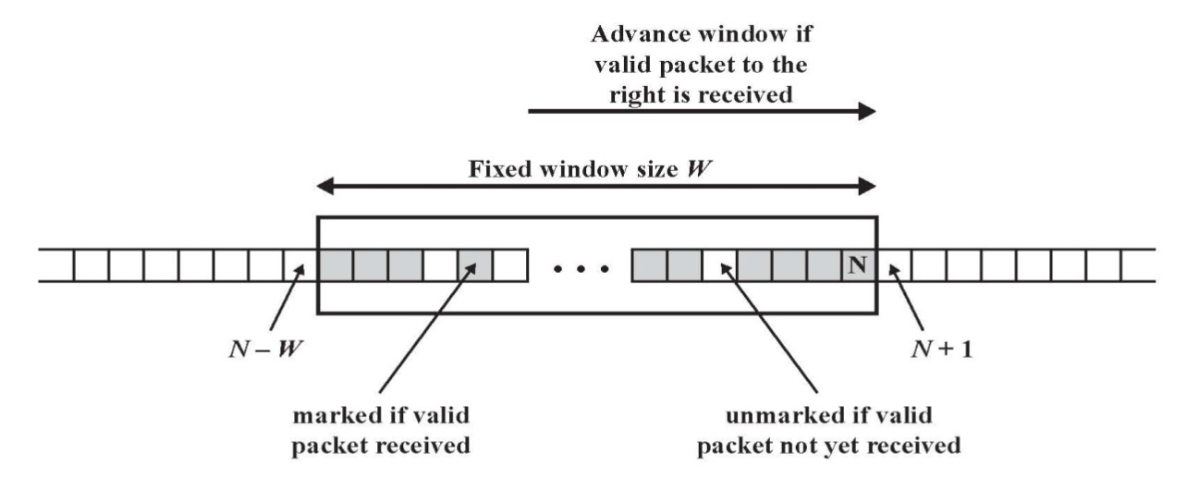
Prevention of Replay Attacks in AH
When SA is established, sender initializes 32-bit counter to 0, increments by 1 for each packet
If wraps around 2³²-1, new SA must be established
Recipient maintains a sliding 64-bit window
If a packet with high sequence number is received, do not advance window until packet is authenticated

Slide 92
Combining Security Associations
SAs can implement either AH or ESP
To implement both need to combine SAs
form a security bundle

Slide 93
Selection of Protocol Modes (Host-to-Host)
Transport Mode
Tunnel Mode

Slide 94
Selection of Protocol Modes (Router-to-Router)
Tunnel Mode

Slide 95
Selection of Protocol Modes (Pass-through IPSec)
Tunnel mode for gateway-to-gateway
Transport mode / tunnel mode for host-to-host

Slide 96
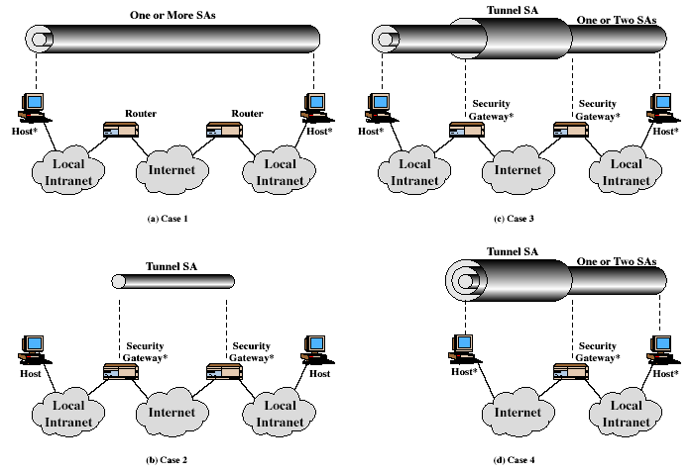
Selection of Protocol Modes (Remote access)
Tunnel mode for host-to-gateway
Transport mode / tunnel mode for gateway-to-host

Slide 97
IPsec Drawbacks
Processing performance overhead
Protection is applied to all traffic, though only a small portion may be security-sensitive
Blocks access to non-IPsec hosts
Hosts must have security association
Not great for short-lived connections
Not practical for broadcast

Slide 98
Internet Security Association and Key Management Protocol (ISAKMP)
Its role is to define the procedures and packet formats to establish, negotiate, modify, and delete security associations.
It defines packet formats for exchanging key (IKE) generation and authentication data.
It does not specify any specific protocol but provides building blocks for various Domains of Interpretations and Key-Exchange protocols.

Slide 99
ISAKMP
ISAKMP Header Format

Slide 100
ISAKMP
Generic Payload Header
The initiator cookie field is cookie that initiated the SA process.
The responder cookie field contains the cookie of the responding identity.
A "cookie" or anti-clogging token (ACT) is aimed at protecting the computing resources from attack without spending excessive CPU resources to determine its authenticity.
An exchange prior to CPU-intensive public key operations can thwart some denial of service attempts (e.g. simple flooding with bogus IP source addresses).

Slide 101
ISAKMP
The major and minor version fields indicates the corresponding version of the ISAKMP in use.
The conventional Payloads are:-
Security Association (SA), Proposal (P), Transform (T), Key Exchange (KE), Identification (ID), Certificate (CERT), Certificate Request (CR), Hash (HASH), Signature (SIG), Nonce (NONCE), Notification (N), Delete (D).
There are five types of exchanges
Base, Identity Protection, Authentication Only, Aggressive and Informational.

Slide 102
IPSec Overview.

